Slide 1
DeFi East Meets West
Bird's-eye View of the Emergent Ethereum DeFi Microcosm
Oct 7, 2019 | Osaka, Japan
Camila Russo, Founder - The Defiant
Diane Dai, Founder - CypherJump & DeFi Labs

Slide 2
East vs. West: Myths or Reality?
“It seems like most of DeFi is happening in the West, but maybe there’s a whole new world of projects in Asia that we don’t know about.”
PROJECTS
“Most DeFi users come from Western countries, while Eastern users are more concentrated in centralized products.”
USERS
INVESTORS
“There are few Asia-based investors focusing on DeFi”

Slide 3
East vs. West: Myths or Reality?
PROJECTS
“Market adoption matters more than full decentralization.”
USERS
“How can I make money from DeFi products?”
INVESTORS
“We don’t take DeFi but open finance as a vertical.”

Slide 4
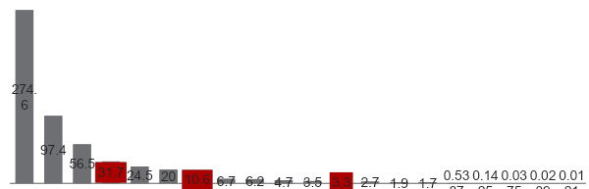
West DeFi ecosystem is 10x larger
Top 20 DeFi projects by region
Value locked (USD, million)
West
$500M
(54% on Maker)
East
$45M
East
West
0.1
0.0
0.0
0.0
Maker
Compound
Synthetix
InstaDApp
dYdX
Uniswap
Nuo Network
Lightning Network
Bancor
WBTC
Dharma
Kyber
Set Protocol
Nexus Mutual
bZx
Augur
Melon
xDai
Veil
Connext
Source: Defi Pulse (October 5th, 2019)

Slide 5
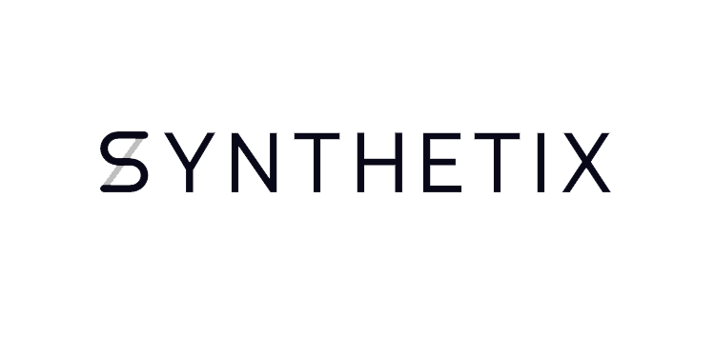






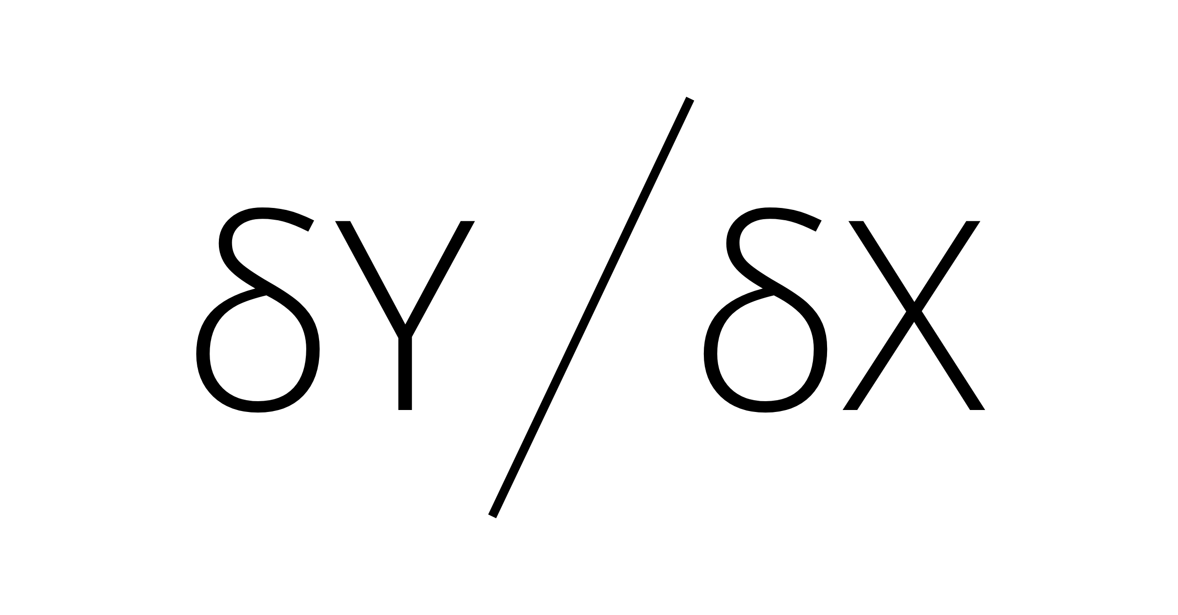

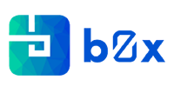







West project ecosystem
Projects in global top 20
Lending
$400M
Derivatives
$60M
80% value concentrated in the lending category
DEX
$26M
Assets
$8M
Payments
$7M
Source: Defi Pulse (October 5th, 2019)

Slide 6








East project ecosystem
Most significant projects in the East
Project | Category | Market Cap/Valuation （$Mil）
 | Dark Pool | 35
 | DEX | 32
 | Indexed Stablecoin | 20
 | Stablecoin & Lending | 10
 | DEX & Lending | 4
 | Oracle | 2
 | Lending | 1.25
Most of eastern DeFi projects have issued tokens.
Tokenless? No.
Source：Coinmarketcap

Slide 7









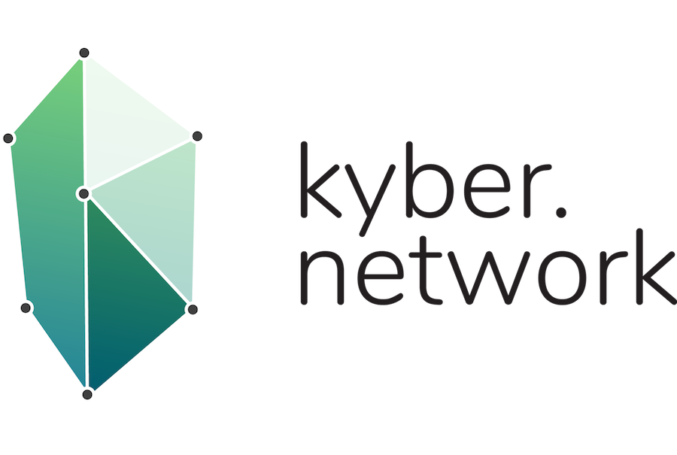


Most key investors in Top 20 Global DeFi projects are based in western countries
Naval Ravikant
Fund based in Eastern country
Source: Crunchbase, Craft.co

Slide 8










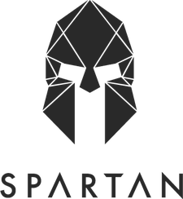



Emerging DeFi investors in the East
Sequoia
China
Fund based in Eastern country
Source: Crunchbase, Craft.co

Slide 9


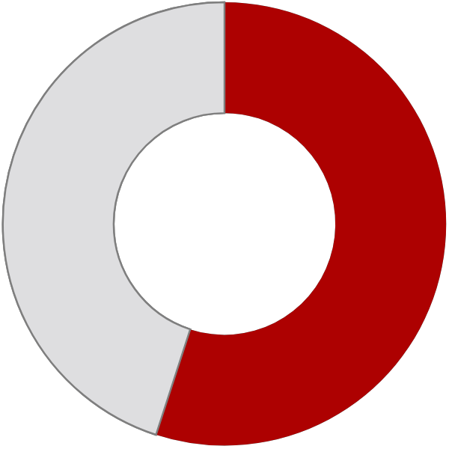


Clear potential for wider adoption in East
Significant share of users from Eastern countries
Plenty of room to increase DeFi adoption in the East
Project | HQ | Top 4 Geographies (by web visits)
Maker |  | 20% CHN | 20% USA | 6% GBR | 4% DEU
Compound |  | 21% USA | 15% CHN | 12% TWN | 7% GBR
Synthetix |  | 18% USA | 17% AUS | 6% CHN | 6% SVN
InstaDapp |  | 42% USA | 5% CHN | 5% IRL | 4% CAN
dYdX |  | 30% USA | 25% CHN | 5% GBR | 5% NLD
Uniswap |  | 27% USA | 8% GBR | 7% CHN | 6% DEU
Nuo Network |  | 21% USA | 9% NLD | 9% MYS | 9% GBR
Lightning |  | 19% USA | 10% COL | 8% CHN | 6% SVK
Bancor |  | 12% USA | 11% SVN | 5% RUS | 5% IND
Dharma |  | 38% USA | 6% GBR | 5% TWN | 5% AUS
% ETH trading volume
West
45 %
55 %
East
Western countries
Eastern countries
Source: Intotheblock, SimilarWeb (October 5th, 2019)

Slide 10
Thank You!
Reach us at:
camila@camirusso.com
TW: @camirusso
thedefiant.substack.com
diane@cypherjump
TW : @diane_0320
Oct 7, 2019 | Osaka, Japan
Camila Russo, Founder - The Defiant
Diane Dai, Founder - CypherJump & DeFi Labs

